Slide 1


Best Practices & Practical Training for Project Managers and Supervisors
November 15, 2023
cohenseglias.com
GEORGE E. PALLAS

Slide 2

Meet the presenter
George E. Pallas
Cohen Seglias Partner
Best Practices & Practical Training for Project Managers and Supervisors
2

Slide 3


Topics
  Critical Aspects of Successful Project Management
  Best Practices and Practical Training for Handling Contract Changes
  Other Important Contract Provisions
  Claims: Notice and Preservation
  Claims: Notice of Delays
  Project Documentation Best Practices
  Wrap Up

Slide 4

Critical Aspects of Successful Project Management

Slide 5

Keys to Success
  Excellent project management from start to finish
  Be adaptable and proactive—understand how the project is changing and be nimble enough to adapt to recognize new risks or opportunities
  Document all issues, changes, oral communications, delays, and other disruptions or interferences in the field work.

Slide 6
What kind of skills does a good project manager have?
Consistent and regular maintenance of critical project records
  Notices
  Written confirmation of directives, authorizations
  Daily reports
  T&M tickets
  CORs

Slide 7

Best Practices and Practical Training for Handling Contract Changes

Slide 8

Scenario 1
  Owner and contractor agree that a specific condition was not contemplated by the contract documents.
  Owner and contractor agree that extra work is required.

Slide 9
Scenario 1
  The owner or GC verbally tells you to make the change but not to worry about paperwork at this time because the job is on a tight schedule.
  Are you obligated to accept the direction and perform the change?
No!

Slide 10

Scenario 1
  What if it is a minor change that does not affect your costs or the time to perform your work?
  Are you then obligated to proceed with the verbal direction to proceed with the work?

Slide 11

Minor Changes in Work
AIA A201-2017 §7.4 “Minor Changes in the Work”
  The Architect may order minor changes in the Work that are consistent with the intent of the contract documents and do not involve an adjustment in the Contract Sum or extension of the Contract Time. The Architect’s order for minor changes shall be in writing and shall be binding on the Contractor. If the Contractor believes that the proposed minor change in the work will affect the contract sum or contract time, the contractor shall notify the Architect and shall not proceed to implement the change in the work. If the Contractor performs the works set forth in the Architect’s order for a minor change without prior notice of the Architect that such change will affect the contract sum or contract time, the Contractor waives any adjustment to the contract sum or extension of the contract time.

Slide 12

Minor Changes in Work
Best Practice for Minor Changes:
  Demand a written directive to perform the minor change, signed by the owner, in accordance with the provisions in the contract documents that govern “changes.”
  Because a minor change does not involve change in contract amount or time, there is no impact to job costs.

Slide 13
Scenario 1
  What if the changed condition is not minor, and the contractor and owner agree on the changes to the contract price and contract time?
  Do you proceed with the work before you receive the signed change order?

Slide 14

CHANGE ORDERS
  Most contracts will expressly state that contractor is not entitled to compensation for changed conditions without an executed change order.

Slide 15
Change Orders
AIA A201-2017 §7.2.1 “Change Orders”
  A Change Order is a written instrument prepared by the Architect and signed by the Owner, Contractor, and Architect, stating their agreement upon all of the following:
    The change in the Work;
    The amount of the adjustment, if any, in the Contract Sum; and
    The extent of the adjustment, if any, in the Contract Time.

Slide 16
CHANGE ORDERS
Best Practice:
  Notify the owner (or GC) in writing of the changed condition.
  Send a change order request to the owner/GC.
  Wait for a signed change order.

Slide 17
Scenario 1
  What if the owner requires the contractor to immediately begin the changed work, but a change order cannot be issued before the work begins?
  Are you obligated to proceed?
  Should you proceed with the changed work?

Slide 18
Scenario 1
Best Practice:
  Demand that the owner/GC provide you with a written directive to proceed with the work under agreed-upon terms.
  If owner does not, then you should send written communication confirming agreed-upon terms.
  Submit a change order request that reflects the agreed-upon terms.

Slide 19
Scenario 1
Before signing a change order, you should ask the following questions:
  Does change order cover all costs to perform extra work?
  Does change order provide an extension of time to perform extra work?
  Does change order account for any delay, impact or extended general condition costs?

Slide 20
BEWARE OF Release by change order
  If the answer to any of these questions is “no”, then you must, on the face of the change order, reserve your rights.
  Include language indicating, for instance, that the change order excludes all delays, disruptions and inefficiencies experienced by the contractor to date and associated with this particular increased scope of work.

Slide 21
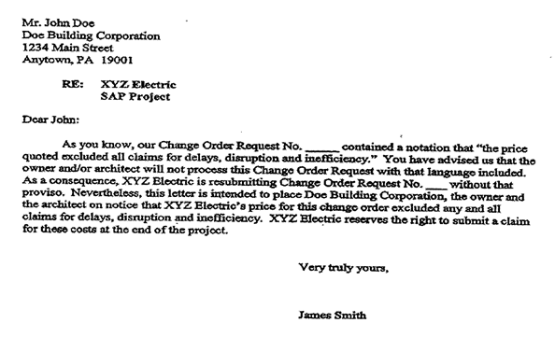
What happens if owner will not sign/or modify the change order?
Sample letter regarding a change order

Slide 22
Handling Contract Changes
Scenario 2

Slide 23
Scenario 2
  The owner and contractor agree that a specific condition was not contemplated by the contract documents, and that the contractor is required to perform extra work.
  However, the owner and contractor do not agree on the change to the contract price or the contract time.

Slide 24
Scenario 2
What do you do in this instance?
  A construction change directive (CCD) is the method to address this situation.
  The CCD is signed by the owner, and directs the contractor to perform the extra work. The CCD leaves open the effect the changed work has on the contract price or the contract time.
  As a result, most contracts direct the contractor to separately track its costs and time when performing the extra work directed by a CCD.

Slide 25
Construction Change Directives
AIA A201-2017 §7.3.1 “Construction Change Directives”
  A Constructive Change Directive is a written order prepared by the Architect and signed by the Owner and Architect, directing a change in the Work prior to agreement on adjustment, if any, in the Contract Sum or Contract Time, or both. The Owner may by Constructive Change Directive, without invalidating the Contract, order changes in the Work within the general scope of the Contract consisting of additions, deletions, or other revisions, the Contract Sum and Contract Time being adjusted accordingly.

Slide 26
Scenario 2
After the CCD has been issued, and you set up all of the correct cost codes, how are you going to keep the owner updated on the progress of the work, and the fact that you are incurring costs and time?
  Because many contracts require accurate tracking of CCD-directed work, you should prepare daily time-and-material (T&M) tickets that accurately reflect the manpower, time spent, tasks performed, supervision, materials utilized, transportation costs, machinery and equipment costs, and rental costs.

Slide 27
Scenario 2
  The owner or its authorized representative must sign T&M tickets.
  Sometimes the owner or its authorized representative will “stamp” the T&M ticket with a statement that says something like they are only signing to verify that the work was performed and the materials were supplied, but they are not signing to approve payment.
Do you care?
No!
  This is an acceptable practice, as long as they sign the T&M ticket.
  Why? When the owner or GC signs the T&M ticket, it cannot later dispute the accuracy of the time spent and materials that were utilized.

Slide 28
Scenario 2
What if the owner or its authorized representative refuses to sign the T&M ticket?
  Ask why, and try to resolve the issue. It may be a simple dispute over a quantity of materials, or labor hours.
  If the dispute cannot be resolved, then make a note on the T&M ticket that they refused to sign.

Slide 29
Once the daily T&M Ticket has been signed (or not), what do you do next?
Best Practices:
  Send them to your home office, where they will be compiled and the time and expenses will be accounted for in your costs reports and schedules.
  On a daily, or at least weekly, basis, the home office should send them to the owner/GC with an accompanying letter.
    Send to the owner/GC’s address provided in the contract (look for the “notice” provision)
    You should also send it via email
  This way, the owner is kept apprised of the progress of the CCD, and has an opportunity to dispute the T&M tickets.
  If the owner does not dispute the T&M tickets, they “own” them.

Slide 30
Scenario 2
What do you do if the owner does not issue a change order, or issues one for less money or time than what was requested?
  Review the “disputes” or “claims” provisions of your contract and the contract documents.
  You may need to immediately file a claim in order to preserve your rights.

Slide 31
Handling Contract Changes
Scenario 3

Slide 32
Scenario 3
  The contractor believes that a specific condition was not included in the contract documents, requiring it to perform extra work. The contractor believes it is entitled to a change to the contract price and the contract time.
  The owner believes that the specific condition was included in the contract documents, so the owner demands that the contractor perform the work. The owner will not agree to any changes to the contract price or the contract time.

Slide 33
Scenario 3
  This is a typical scenario that contractors face every day: is the “extra work” included in the contract documents, or not?
  In this situation:
    Will the owner (or GC) issue a change order?
    Will the owner (or GC) issue a CCD?

Slide 34
Scenario 3
What do you do in this situation?
  Send a letter to the owner confirming your conversation.
  State that the owner directed you to perform the work, even though the work is not included in your contract.
  State that you will perform the work under protest, and that you will file a claim.

Slide 35
Scenario 3
Unfortunately, in this scenario, there is little that the contractor can do except to initiate a claim under the “disputes” or “claims” provisions of the contract.
  Review your contract to ensure you provide timely notice of your claim and fulfill all other conditions to file a claim.
  Strictly follow the claims procedure in your contract.

Slide 36
Scenario 3
Are you required to perform the disputed, extra work while you are in the claims process?
  Most contracts contain a provision that requires contractors to continue to work while claims are being decided.
  Review your contract and the contract documents for this provision.

Slide 37
Scenario 3
Best Practice:
  In this situation, the better course of action is to perform the work (if it is financially feasible), and maintain complete and accurate records of the costs and time to perform the extra work.
  WHY?

Slide 38
Scenario 3
  If you do not perform the extra work, the owner will engage another contractor to perform the work—probably at a higher cost than what it would have cost you to perform the work.
  The owner may commence a lawsuit (or arbitration) against you for breach of contract to recover the additional costs, which may include delay costs associated with the time to engage another contractor.

Slide 39
Scenario 3
  You should track all of your costs and time—just as you would if the owner issued a CCD directing you to perform the work. These will be important in the proof of your claim.
    T&M tickets
    Job costing

Slide 40

Other Important Contract Provisions

Slide 41
NO DAMAGE FOR DELAY PROVISIONS
  Provide that in the event a contractor is delayed by an event which is not the contractor’s fault or within the contractor’s responsibility, the contractor is entitled to an extension of time but not to monetary compensation for the duration of the delay.
  Compensable delay → excusable delay
  No standard language, so can be difficult to spot in a contract.
  May, in some cases, be overcome where a “disruption” or “acceleration” is alleged instead of delay.

Slide 42
NO DAMAGE FOR DELAY PROVISIONS
  Courts in most states recognize exceptions to enforcing broad no-damages-for delay provisions, which generally include the following:
    Delays that are uncontemplated;
    Delays caused by a breach of a fundamental obligation under the contract;
    Delays that are so unreasonable they amount to the abandonment of the contract;
    Delays due to bad faith, fraud, or willful and/or grossly negligent conduct.
Notes:
The more commonly asserted exceptions are due to uncontemplated delays or breach of fundamental contractual obligations. Breach of a fundamental obligation is most commonly interpreted as a breach of a material and explicit provision of the contract that goes to the heart of the agreement. This can be something like a complete failure to provide a schedule (if a schedule was required pursuant to contract). However, application by the courts is not uniform, and there is limited guidance available.
The most commonly asserted exception is for uncontemplated delays. While this may seem like a “catch-all,” it has been interpreted narrowly, as well. Courts have interpreted the exception to mean that if a “type” of delay damage is contemplated by the subject contract, then the exception will not apply. Courts will look for either general categories and/or specific items being “contemplated” (i.e., discussed) in the contract such that a (sub)contractor could reasonably expect it to be a source of delay. When a court makes this assessment, it may search the agreement at varying levels to determine what was contemplated. This can be subjective depending on the court and even the judge, thus leading to inconsistent application where contractors ought to err on the side of prudence.
Notably, there is also an exception to the exception. Courts have used the umbrella concept of “poor planning and inept administration” as a “catch all to the catch all.”
Thus, even if uncontemplated in the contract at issue, the no-damage-for-delay provision may still be enforced if it is a “typical” or “expectable” source of delay

Slide 43
Pay-When-Paid vs. Pay-If-Paid Clauses
  Subcontract agreements typically make the contractor’s obligation to pay the subcontractor contingent upon the GC being paid by the owner.
  Most states enforce “pay-if-paid” provisions if there is clear language unambiguously reflecting an intent by the parties to shift the risk of nonpayment by the owner to the sub.
  Otherwise, provisions are interpreted as addressing the timing of payments.

Slide 44
Dispute Provisions
  Litigation
  Arbitration – AAA rules
  Mediation
  Timing – be aware of not only when but what needs to happen before suit can be brought
  Be aware of and try to avoid “choice of forum” clauses.

Slide 45

Claims
Notice and Preservation

Slide 46
What is a “Claim?”
Look to your contract!
  § 4.3.1: A claim is a demand or assertion by one of the parties seeking, as a matter of right, an adjustment or interpretation of Contract terms, payment of money, extension of time or other relief with respect to the terms of the Contract.
AIA A201-2017 §15.1.1 “Definition” of a Claim
  A claim is a demand or assertion by one of the parties seeking, as a matter of right, payment of money, a change in the Contract Time, or other relief with respect to the terms of the contract. The term "Claim" also includes other disputes and matters in question between the Owner and Contractor arising out of or relating to the Contract. The responsibility to substantiate Claims shall rest with the party making the Claim. This Section 15.1.1 does not require the Owner to file a Claim in order to impose liquidated damages in accordance with the Contract Documents.

Slide 47
Notice provisions
  Avoid notice provisions which require notice within a short period of time (e.g., 24 hours).
  Avoid notice provisions which require the full amount and scope of the damages.
  Beware of contract provisions which require strict compliance and preclude custom and practice.
  Know what the prime contract requires.

Slide 48
Claims
Notice of Delays

Slide 49
Notice of Delay
  What does the contract require?
  Questions for end of each month:
    Are we following the original schedule?
    If not, why not?
    What should we do about it?
    Take appropriate action.
  Don’t assume! Protect!

Slide 50
Questions About Delays
  How do you notify owner or general contractor of delay?
  Should your notice identify specific areas of work impacted by delay?
  Should your notice identify the manner in which you are being damaged by delay?
  How do you quantify days of delay?

Slide 51
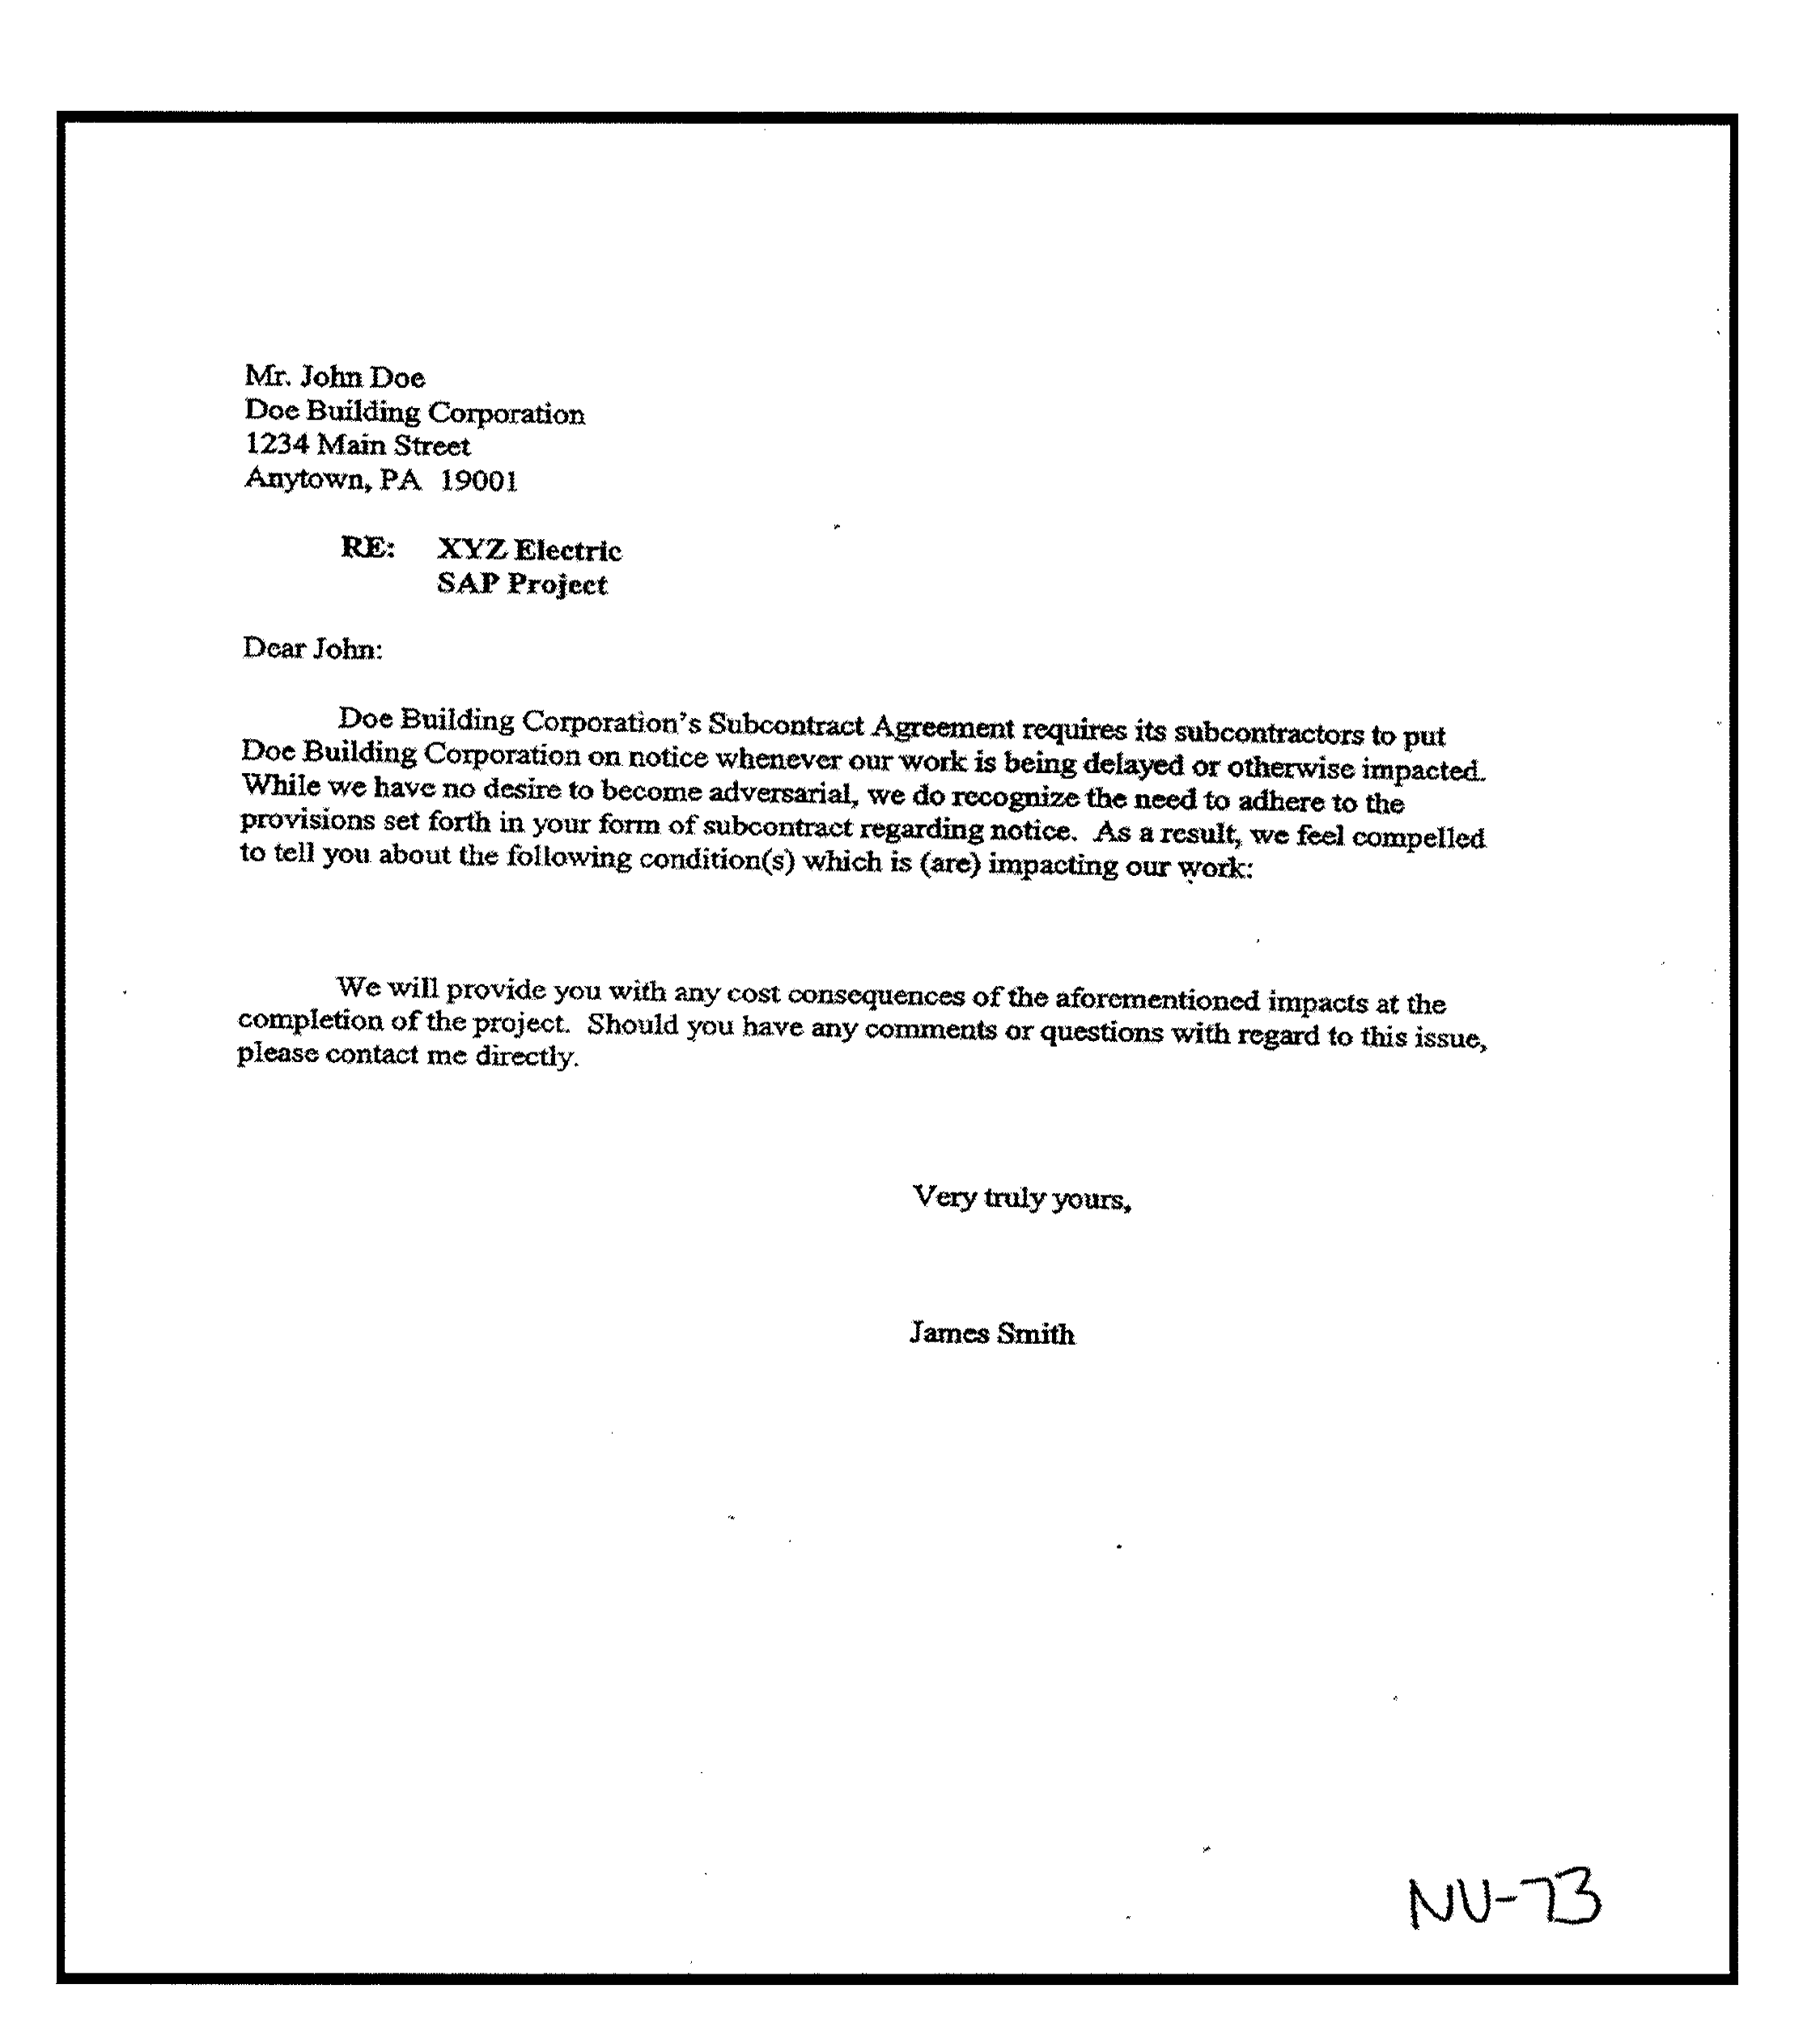

Slide 53
Constructive ACCELERATION
  What should you do if owner denies request for extension of time?
  You could have a claim for constructive acceleration.

Slide 54
Constructive ACCELERATION
  Acceleration is implied when:
    Excusable delays are incurred;
    Contractor specifically requests time extension;
    Owner fails to grant time extension; and
    Owner expressly orders completion within original performance time; or
    Contractor gives notice to owner that its actions constitute constructive acceleration.
  How do you preserve a constructive acceleration claim? You must ask for time extension.

Slide 56
CLAIM PRESERVATION
  Know and understand all notice and claim provisions.
  Send proper and timely notice letters.
  Document all extra and disputed work—and separately track time and costs.
  Do not sign unqualified releases with pay apps!

Slide 57
Beware of PARTIAL/FINAL RELEASES
  Read any release of liens and/or waivers that must be submitted with the payment application.
  Many of these documents will contain a provision that the contractor waives all claims up to the date of the payment application.
  You cannot sign any release of liens and/or waivers without reserving your rights to claims for additional payment and time, which includes pending change order requests and all extra work that you have performed.

Slide 58
Beware of PARTIAL/FINAL RELEASES
  Include a statement on the partial waiver/release form that states the contractor does not waive, and specifically reserves, all claims for additional compensation and additional time for work performed for [insert description].
  Include as much detail that would be necessary for a third party to understand that you are reserving your rights for money and time with respect to specific work.
  What if the owner/GC rejects your additional language?

Slide 59
Beware of PARTIAL/FINAL RELEASES
Best Practice:
  If you need to be paid, then you should sign the Waiver without the additional statement, but you must transmit it with a contemporaneous letter that states the Owner rejected your change, but that you need to be paid, so you have signed the Waiver but you reserve all of your rights.
  In the letter, you should identify all of the Claims for which you are reserving your rights.
  The law is not clear whether this procedure will protect your rights to payment. So, you should consult with your attorney.

Slide 60
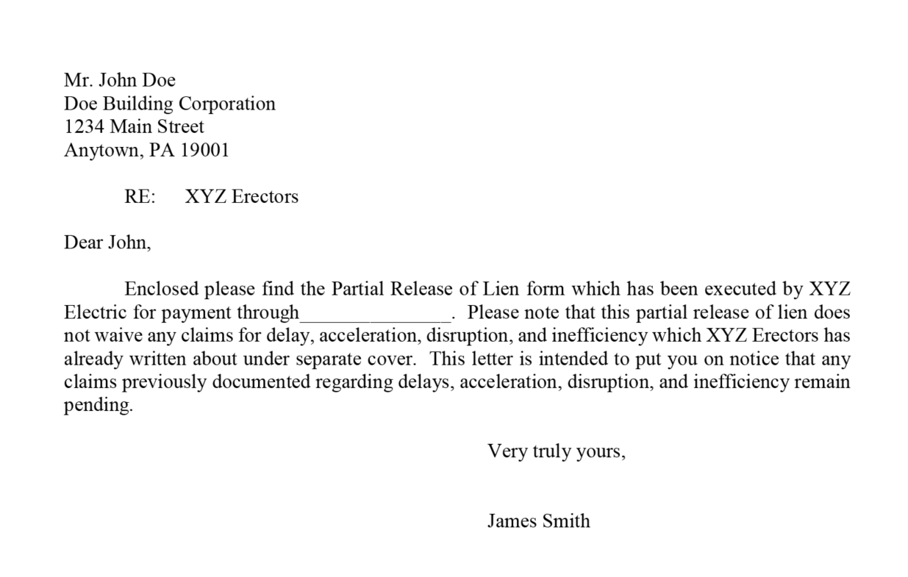

Slide 61

Project Documentation Best Practices

Slide 62
Daily Reports
Critical to establish what actually took place on the job
  Write clearly, avoid slang and foul language
  Note where crews are working and crew sizes
  Note delays and problems, including potential problems
  Note important conversations
  Document weather

Slide 63
Daily Reports
  Document materials delivered
  Note discrepancies in plans
  Describe out-of-sequence work
  Make your company look good!
  Make your own schedule—preferably one that fits in the foreman’s back pocket.

Slide 64
Correspondence
  Be an advocate—support your position.
  Notice letters don’t need to be adversarial to be effective (consider email).
  Object is to put other side on notice so they can deal with the problem.
  Answer every letter in writing and defend your position with facts. (Do not let inaccurate information remain unchallenged, it may come back to haunt you!)
  Keep signed copies and confirmations of fax transmittals.
  Date stamp all incoming documents.

Slide 65
Meeting Minutes
  Review immediately for accuracy.
  Supplement any minutes IMMEDIATELY that do not accurately reflect information at the meeting.
  Do not allow inaccurate information to remain unchallenged.

Slide 66
Wrap Up

Slide 67
Wrap up
  Effective and successful project management depends on being proactively engaged in the proper planning and oversight of work, and identifying and documenting problems, occurrences, changes and claims as they arise.
  Notice provisions can effect your bottom line more than any other clauses, so pay attention to them.
  Realize that there is no correlation between the size of a contract and the money you can lose if left unprotected.

Slide 68
Wrap up
  Provide written notice of all claims, issues, conditions, costs, extra work, delays, inefficiencies and disputes as promptly and specifically as possible.
  Particularly state your intent to seek additional costs or time and note if specific impacts are not yet quantified and be sure to submit them when they are.
  Document all discussions, directives, and events/circumstances impacting work.
  Track and record all costs and extra work.

Slide 69
Questions?
George E. Pallas
gpallas@cohenseglias.com
267.238.4703
Best Practices & Practical Training for Project Managers and Supervisors
69

