Slide 2
BOLT WHAT YOU CAN’T REACH
One-sided connections
Field-weld alternative
Standard hardware
Standard tools
Notes:
Shuriken was originally created for HSS splices, but it works in many applications where access prohibits traditional bolting. By expanding the possibilities for bolted connections, Shuriken limits the need to resort to field welding.
Use of standard bolts and tools mean that Shuriken fits well into existing field practices. It also works with slip-critical connections, and can generally provide higher capacity per bolt than other one-sided bolting solutions.

Slide 3
HOW DOES SHURIKEN WORK?

Slide 4
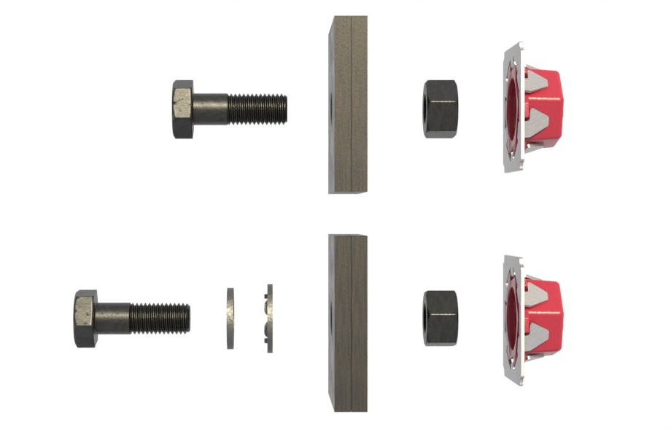
CONFIGURATIONS
Snug Tight
Pretensioned
Notes:
In the 3/4” Shuriken there is space for a washer under the nut, but the cases requiring the washer (Per 2020 RCSC, pretensioned A490 bolt with steel Fy < 40 ksi) is so rare that the washer space was removed from the 7/8” and 1” sizes.

Slide 5
APPLICATIONS – FEATURE STAIRS

Slide 6
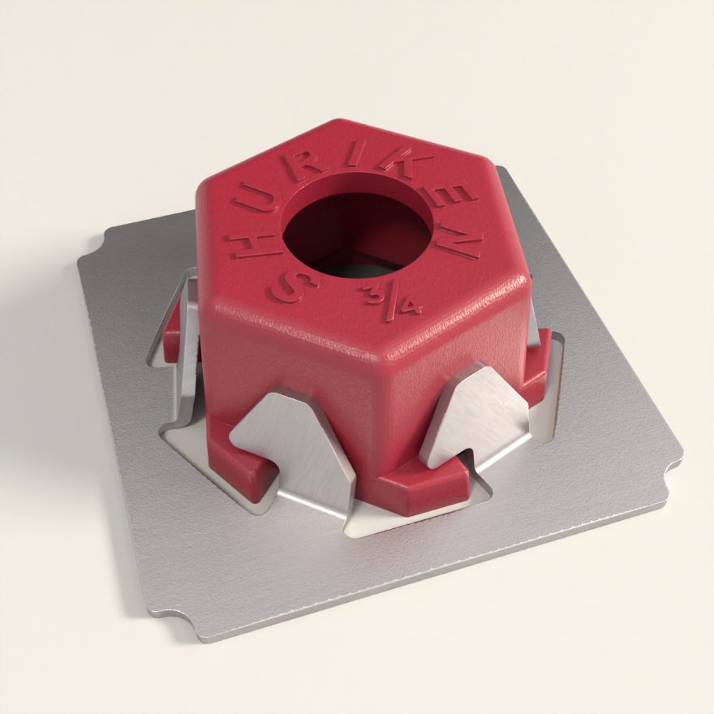
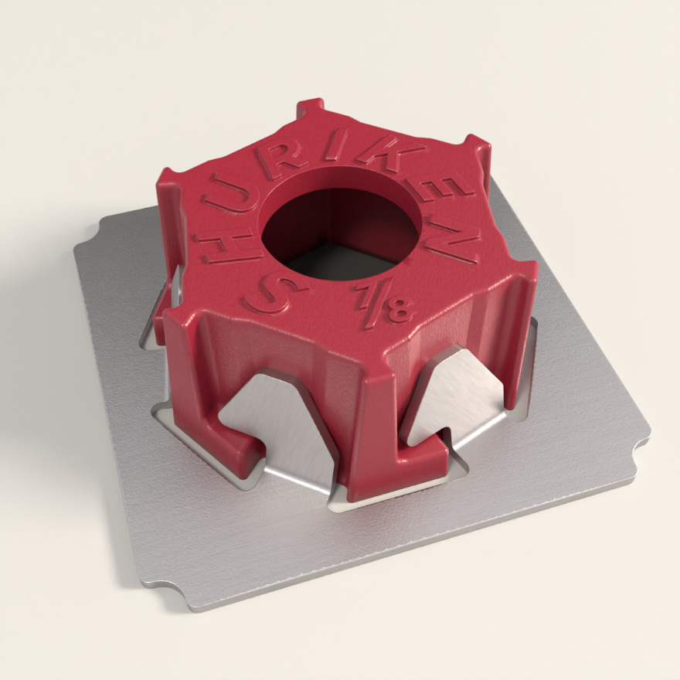
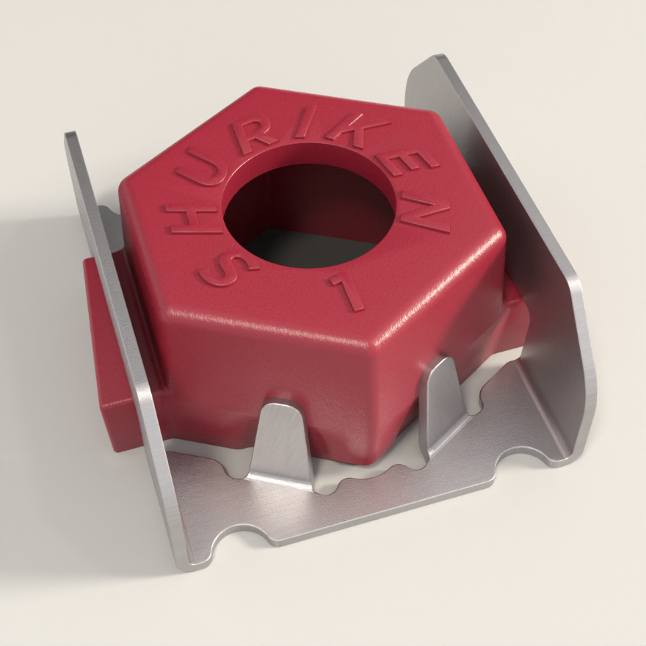
PRICE & AVAILABILITY
$5
$6
$7
Feb. ‘23
Order at atlastube.com/shuriken
or through the Atlas Portal

Slide 7
QUESTIONS

