Slide 1
Building the Manufacturing Workforce Pipeline
Presentation Mid Atlantic Steel Fabricators Association
Susan Herring
Executive Director, Workforce Development
Stephanie Wenger Assistant Director, Workforce Development

Slide 2
BCCC Center for Workforce Development
Customized Training
EARN
Industrial & Technical Training
Out-of-School Youth
In-School Youth
WEDNetPA
ABLE

Slide 3
A few of our clients…
Customized Training
Fred Beans Lower Bucks Hospital Specialty Ring Products Eastern Manufacturing Ryerson, Inc. Christian Heating & Air Siemens Gamesa Wind Penn Community Bank Gelest, Inc. Bucks County Water & Sewer Authority Brad’s Raw PDC Penn Stainless The Rodon Group Secant Medical Fraser Optics SofterWare Schiller Grounds Care Lentzcaping Kinder Morgan
Broad range of topics, including:
- Leadership & Front-line Supervision
- Soft Skills - Lean Six Sigma/Continuous Improvement
- ISO Auditor Training
- Computer applications
- Industrial safety
- Basic Electricity
- Blueprint, GD&T, Schematics Reading
WEDnet/incumbent worker training grant funds
Notes:
Master for Secondary Pages

Slide 4
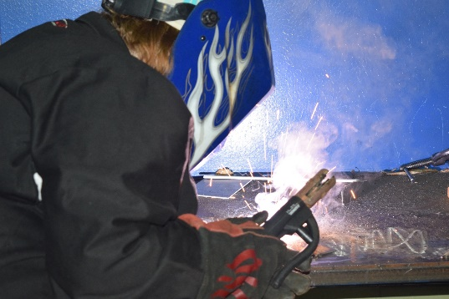
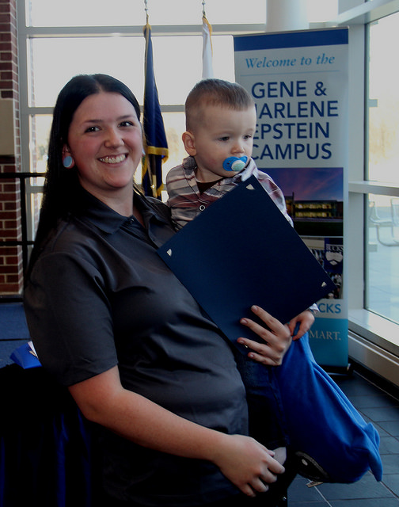
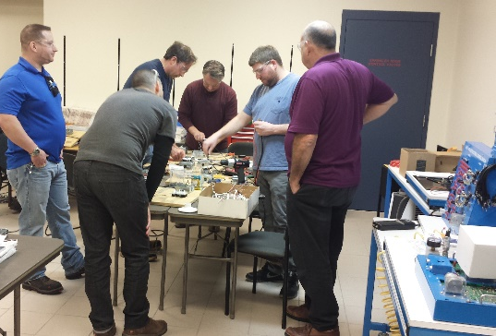
Industrial Skills Pre-Apprenticeship Training Programs

Slide 5
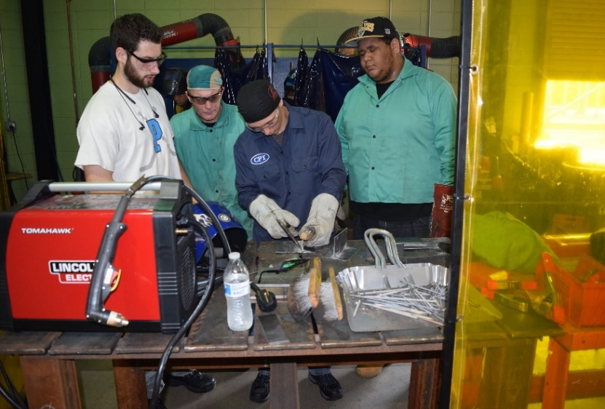
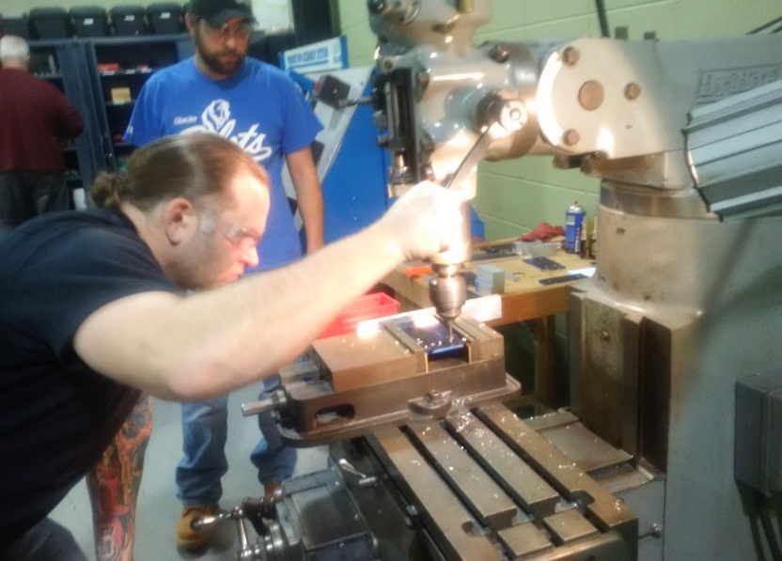
Metalwork Pre-Apprenticeship Training Program
Employer Driven
Entry-level Manufacturing Jobs
200+ Trained throughout Bucks County
90% + Placement Rate
Avg starting rate: $15 to $17/hr
Training recently recognized as a pre-apprenticeship training Program by the PA Dept. of Labor
Notes:
Master for Secondary Pages

Slide 6
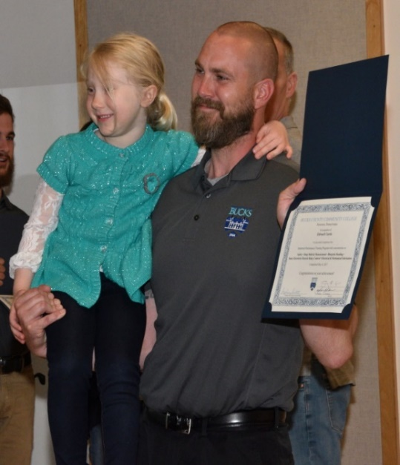
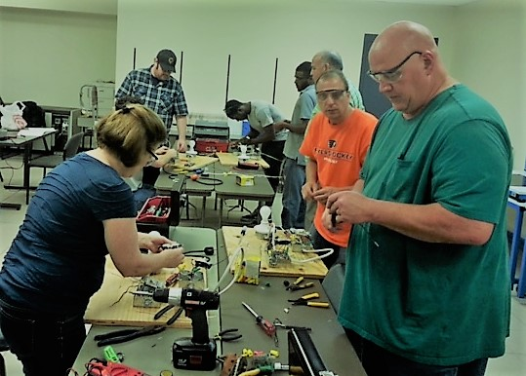
Industrial Maintenance
Pre-Apprenticeship Training Program
Entry-level Electro-Mechanical Technician Jobs
80+ Trained
93% Placement Rate
Avg starting rate: $17 to 20/hr
Notes:
Master for Secondary Pages

Slide 7
Program Details
Metalwork & Industrial Maintenance Pre-Apprenticeship Training Programs
12 weeks
8:30 am – 3:00 pm, Monday – Thursday
UB MW: noon – 6:30pm
Friday morning industry tours
PASmart – NEW Cohort starting February, 2020 for high school students!
Dedicated career coach/job developer & one-on-one recruiter services
Training locations: AMTC, Bristol, BCPSTC, Doylestown & NEW UBC Perkasie
WANTED: Dedicated, committed to attendance, willing to learn and participate actively in the classroom
Notes:
Master for Secondary Pages

Slide 8
Program Details, cont.
Metalwork & Industrial Maintenance Pre-Apprenticeship Training Programs
Competitive screening process:
- Interviews with College Staff and Employers
- Aptitude Assessment
- Drug testing (pass/fail)
- Criminal Background Checks
Entry Requirements:
- HS Diploma/GED
- Reliable transportation
- Lift 50 lbs.
Funding eligibility: dependent on source (unemployed/underemployed)
Notes:
Master for Secondary Pages

Slide 9
Training Descriptions and Approach
Metalwork & Industrial Maintenance Pre-Apprenticeship Training Programs
Intro to Manufacturing & Safety, Shop Math & Measurement, Blueprint Reading, Employability Skills, Financial Literacy, Resume and Interviewing
Metalwork:
- Hand tools, AutoCAD, Welding, Machining
Industrial Maintenance:
- Basic Electricity/Electrical Fab, Electric Relays, PLCs, Mechanical Fabrication
Notes:
Master for Secondary Pages

Slide 10
Training Descriptions and Approach
Metalwork & Industrial Maintenance Pre-Apprenticeship Training Programs
Nationally recognized credentials
OSHA 10
OSHA Forklift Safety
- National Institute for Metalworking Skills (NIMS) exam for Measurement, Materials, and Safety Certification
Notes:
Master for Secondary Pages

Slide 11
Workforce Scene: What Young Workers Want
Investment by employer – training, opportunity to build skills - technical and soft skills
Employer engagement – communication, feedback, included in decision making, transparency
Flexibility in work schedule
Work that has meaning (social impact, volunteerism)
BCCC hosting free employer breakfast – November 15
Notes:
Master for Secondary Pages

Slide 12
Overcoming Workforce Challenges
Questions?

Slide 13
Thank you!
Contact Information:
Susan Herring Stephanie Wenger
susan.herring@bucks.edu stephanie.wenger@bucks.edu
215-968-8364 215-968-8478
Notes:
Master for Secondary Pages

